Slide 1
MVC Architecture In Java
K.SAI KUMAR
23H51A6224

Slide 2
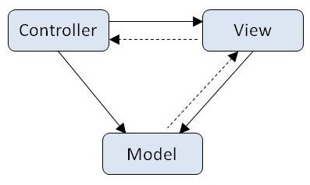
Introduction to MVC Architecture
MVC stands for Model-View-Controller, which is a design pattern widely used in software development.
This architecture separates an application into three interconnected components for better organization.
It enhances maintainability, scalability, and testability of applications.
Notes:
Image source: https://www.freecodecamp.org/news/the-model-view-controller-pattern-mvc-architecture-and-frameworks-explained/

Slide 3
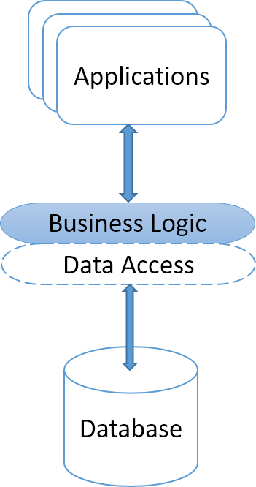
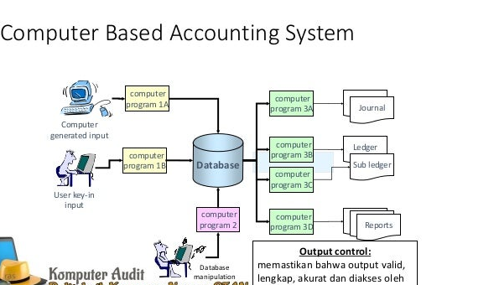
NEED OF MVC ARCHITECTURE
MVC architecture helps you to organize your web application and make it more manageable.
It allows you to separate business logic from presentation logic, which makes it very easy to add new features or change existing ones without affecting the whole application.
Changing to

Slide 4
Components of MVC AND WORK FLOW
The Model represents the data layer and business logic of the application.
The View is responsible for the presentation layer, displaying the data to the user.
The Controller acts as an intermediary, handling user input and updating the Model and View accordingly.
Notes:
Image source: https://learnbatta.com/course/django/mtv-architecture/

Slide 5
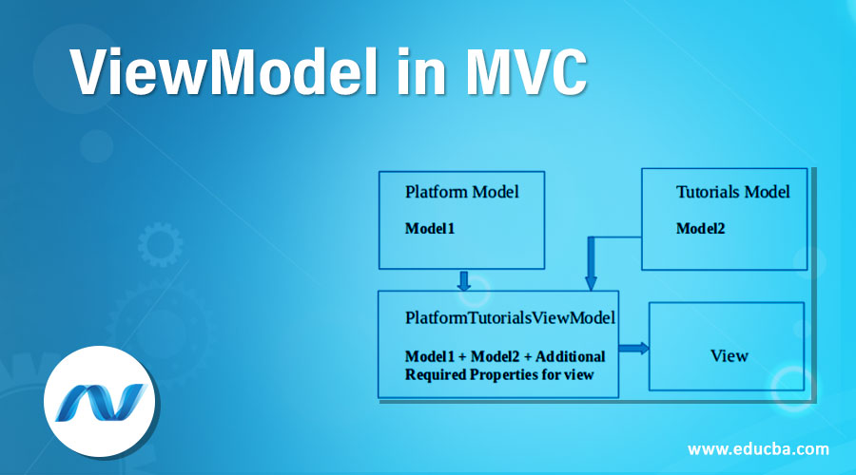
Model in MVC
The Model encapsulates the core functionality of the application, managing data and business rules.
It is responsible for retrieving data from the database, processing it, and sending it to the View.
Changes in the Model can trigger updates in the View, ensuring data consistency.
Notes:
Image source: https://www.gabormelli.com/RKB/model%E2%80%93view%E2%80%93controller_pattern

Slide 6
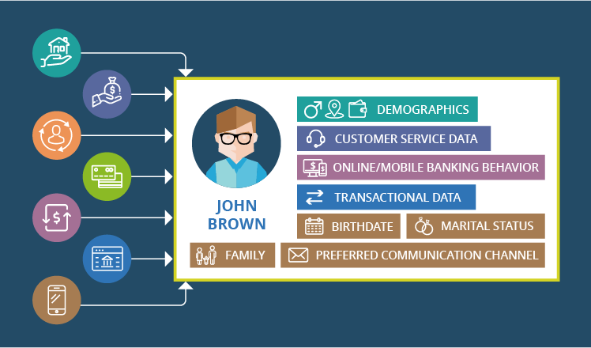
View in MVC
The View displays data to the user and presents the user interface elements.
It retrieves data from the Model to render it appropriately, ensuring a user-friendly experience.
The View is updated based on user interactions and notifications from the Controller.
Notes:
Image source: https://www.vrogue.co/post/tutorial-belajar-laravel-pengertian-mvc-model-view-controller

Slide 7
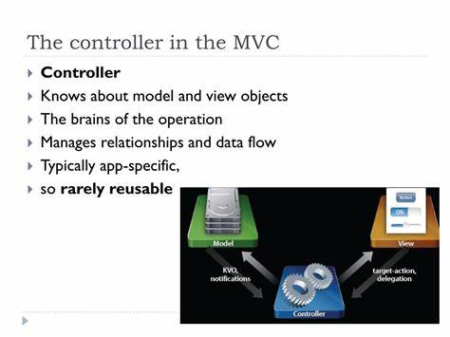
Controller in MVC
The Controller interprets user input from the View and communicates with the Model.
It processes user requests, manipulates the Model, and determines which View to render.
The Controller serves as the link between the Model and the View, allowing for a seamless flow of information.
Notes:
Image source: https://projectmanagementdud.blogspot.com/2013/03/model-view-controller-mvc-simply.html

Slide 8
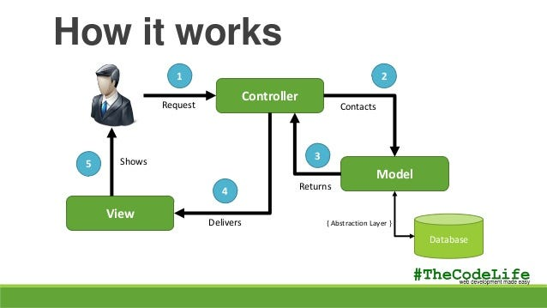
Benefits of MVC Architecture
MVC promotes a clean separation of concerns, allowing developers to work on different components simultaneously.
It enhances code reusability, as Models, Views, and Controllers can be modified independently.
The architecture simplifies testing, as individual components can be unit tested without needing the entire application.
Notes:
Image source: https://www.interviewbit.com/blog/mvc-architecture/

Slide 9
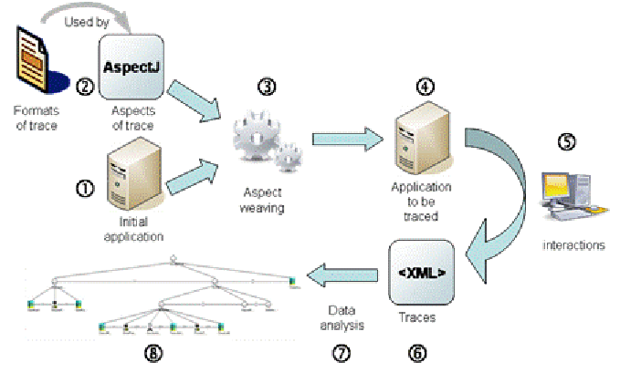
MVC Frameworks in Java
Several frameworks in Java implement the MVC design pattern, including Spring MVC and JavaServer Faces (JSF).
These frameworks provide built-in support for routing, session management, and data binding.
They facilitate the development of robust web applications, adhering to the MVC principles.
Notes:
Image source: https://www.freecodecamp.org/news/the-model-view-controller-pattern-mvc-architecture-and-frameworks-explained/

Slide 10
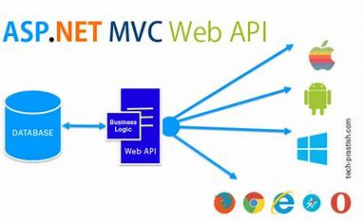
Applications OF MVC
Web Applications:
1. Spring Framework
2. Play Framework
3. Vaadin
Desktop Applications:
1. Swing.
2. JavaFX.
Mobile Applications:
1.Android
Enterprise Applications:
1.Java Enterprise Edition (EE)
Notes:
Image source: https://www.youtube.com/watch?v=XClzEdH09C8

Slide 11
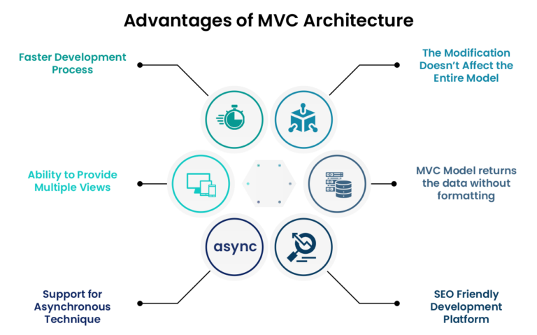
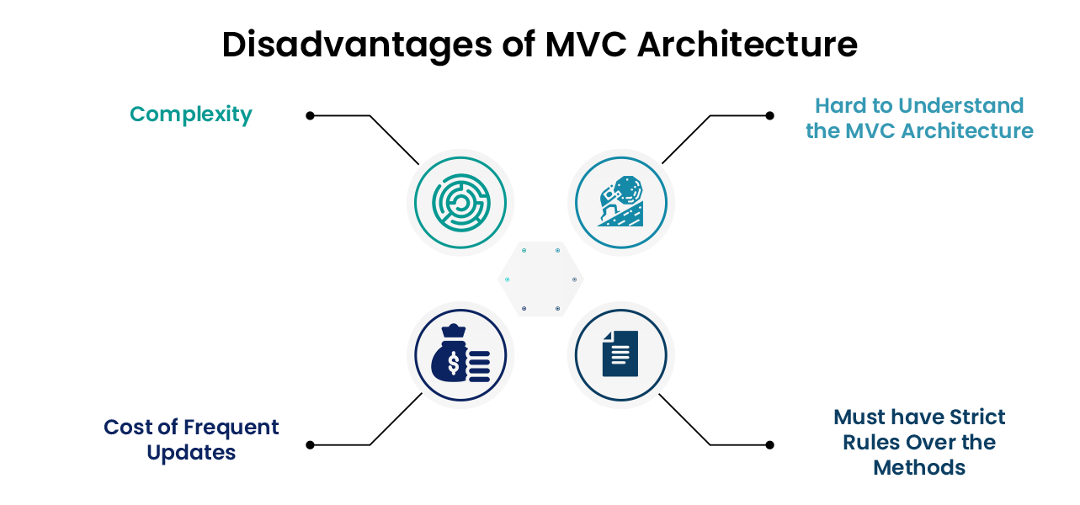
Advantages
Improved Response Time
Efficient Data Management
Better Error Handling
Knowledge Sharing
Secure Data Storage
Business Logic
Platform Independence
Easy Integration
Advantages
Tight Coupling
Hard to under stand
Cost of frequent update
Not suitable for small applications
Requires knowledge of several
technologies

Slide 12
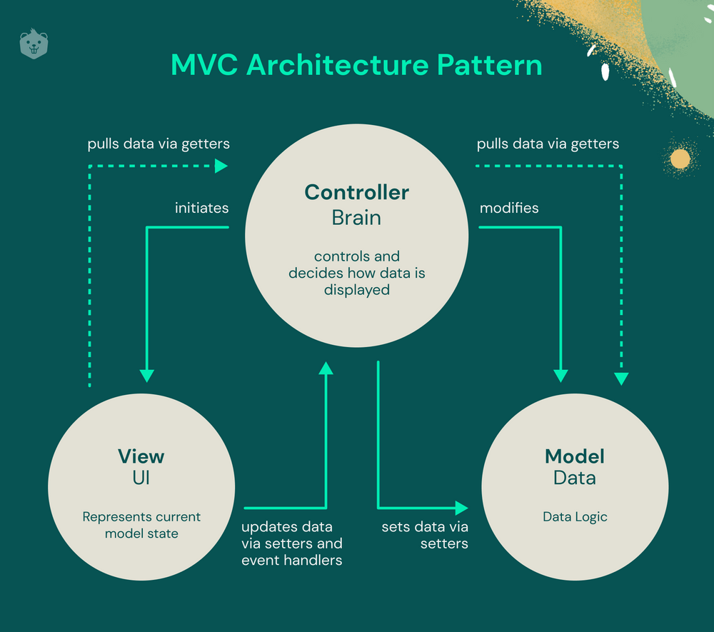
Conclusion
MVC Architecture is a powerful design pattern that enhances the organization of Java applications.
It allows for independent development and maintenance of application components, improving overall productivity.
Understanding MVC is essential for developers aiming to build scalable and maintainable software solutions.
Notes:
Image source: https://www.crio.do/blog/understand-mvc-architecture/

Slide 13


